Slide 1
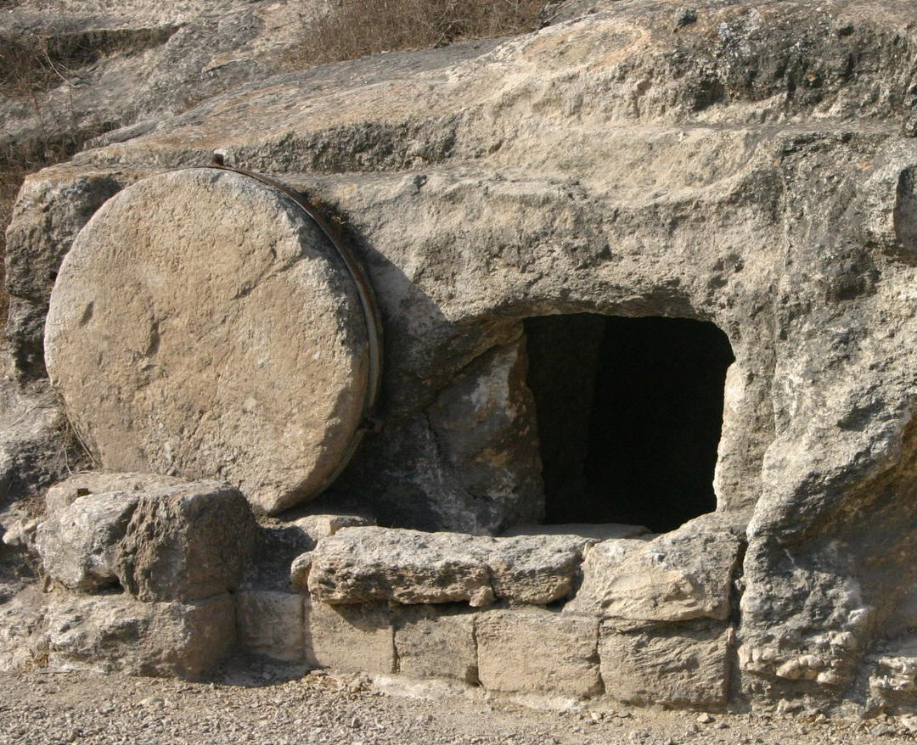
THE LIFE OF CHRIST

Slide 2
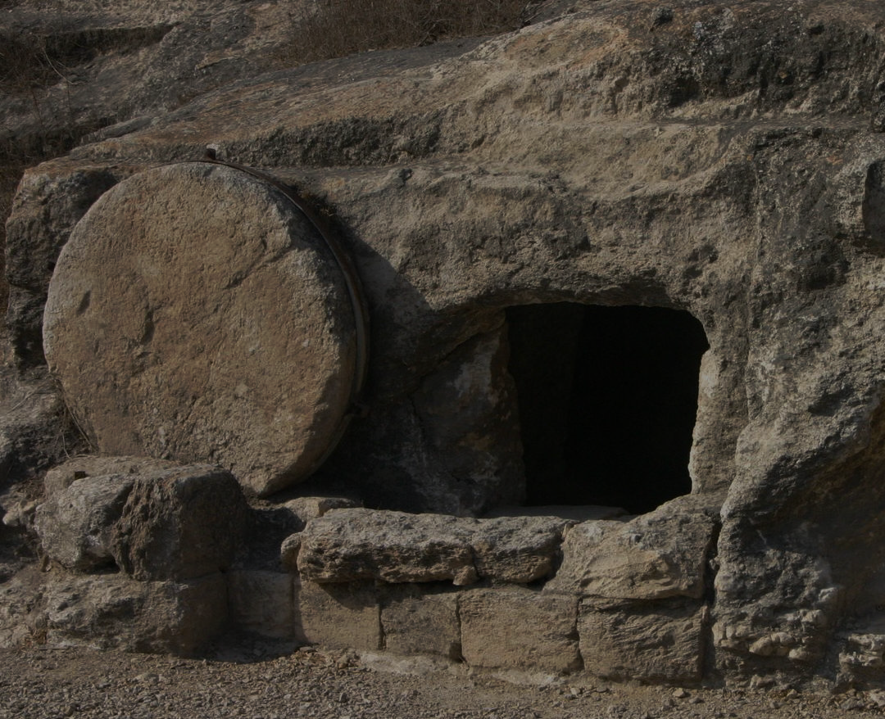
John 20:1 Now on the first day of the week Mary Magdalene went to the tomb early, while it was still dark, and saw that the stone had been taken away from the tomb. ² Then she ran and came to Simon Peter, and to the other disciple, whom Jesus loved, and said to them, "They have taken away the Lord out of the tomb, and we do not know where they have laid Him."

Slide 3
While John only mentions Mary Magdalene, the other accounts mention the other women that were there including Mary the mother of James, Salome and Joanna (Mt. 28:1; Mk 16:1: Lk. 24:1, 10; Jn. 20:1).

Slide 4
John’s account says that Mary Magdalene went to the tomb while it was still dark (Jn. 20:1). Luke says it was early in the morning (Lk. 24:1). Matthew says the day was beginning to dawn as they made their way to the tomb (Mt. 28:1). Mark tells us it was early in the morning, but when they arrived at the tomb the sun had risen (Mk. 16:2).

Slide 5
Matthew 28:2 And behold, there was a great earthquake; for an angel of the Lord descended from heaven, and came and rolled back the stone from the door, and sat on it. 3 His countenance was like lightning, and his clothing as white as snow. 4 And the guards shook for fear of him, and became like dead men.

Slide 6
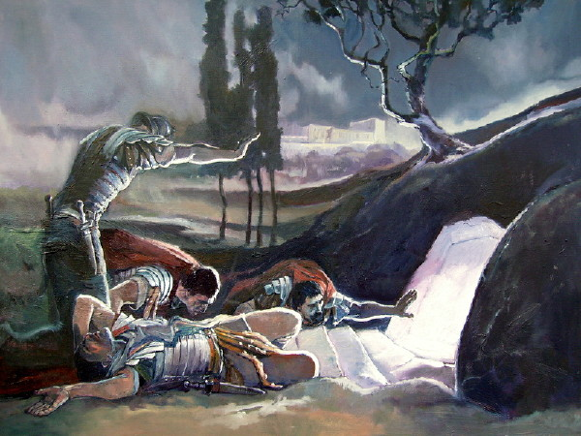

Slide 7
The women wondered who would roll the stone away for them, but when they arrived at the tomb they found the very large stone already rolled away, which proves the soldiers’ experience happened before they arrived (Mk. 16:3-4; Lk. 24:2; Jn 20:1).

Slide 8
Matthew and Mark tells us there was an angel, described as a young man with a long white robe, sitting on the right side (Mt. 28:5; Mk. 16:5), but Luke’s account tells us there were two angels that stood by them in shinning garments (Lk 24:4).

Slide 9
Luke 24:5 Then, as they were afraid and bowed their faces to the earth, they said to them, "Why do you seek the living among the dead? 6 "He is not here, but is risen! Remember how He spoke to you when He was still in Galilee, 7 "saying, 'The Son of Man must be delivered into the hands of sinful men, and be crucified, and the third day rise again.' " 8 And they remembered His words.

Slide 10
Mark 16:6 But he said to them, "Do not be alarmed. You seek Jesus of Nazareth, who was crucified. He is risen! He is not here. See the place where they laid Him. 7 "But go, tell His disciples -- and Peter -- that He is going before you into Galilee; there you will see Him, as He said to you." (See Mt. 28:5-7).

Slide 11
When the angels instructed them they listened, and they fled from the tomb and were amazed, full of joy, and fear (Mt. 28:8; Mk. 16:8). Mark’s account says the women said nothing to anyone, which some say is a contradiction since the other accounts say they told the disciples what happened. All Mark is saying is that they did not tell anyone on their way to the disciples, and after Jesus encouraged them not to be afraid (Mt. 28:10), they found the disciples and told them about their experience.

Slide 12
John 20:2 Then she ran and came to Simon Peter, and to the other disciple, whom Jesus loved, and said to them, "They have taken away the Lord out of the tomb, and we do not know where they have laid Him."

Slide 13
Luke 24:9 Then they returned from the tomb and told all these things to the eleven and to all the rest. 10 It was Mary Magdalene, Joanna, Mary the mother of James, and the other women with them, who told these things to the apostles. ¹¹ And their words seemed to them like idle tales, and they did not believe them.

Slide 14
John 20:3 Peter therefore went out, and the other disciple, and were going to the tomb. ⁴ So they both ran together, and the other disciple outran Peter and came to the tomb first. ⁵ And he, stooping down and looking in, saw the linen cloths lying there; yet he did not go in. ⁶ Then Simon Peter came, following him, and went into the tomb; and he saw the linen cloths lying there, ⁷ and the handkerchief that had been around His head, not lying with the linen cloths, but folded together in a place by itself. ⁸ Then the other disciple, who came to the tomb first, went in also; and he saw and believed. ⁹ For as yet they did not know the Scripture, that He must rise again from the dead. ¹⁰ Then the disciples went away again to their own homes.

Slide 15
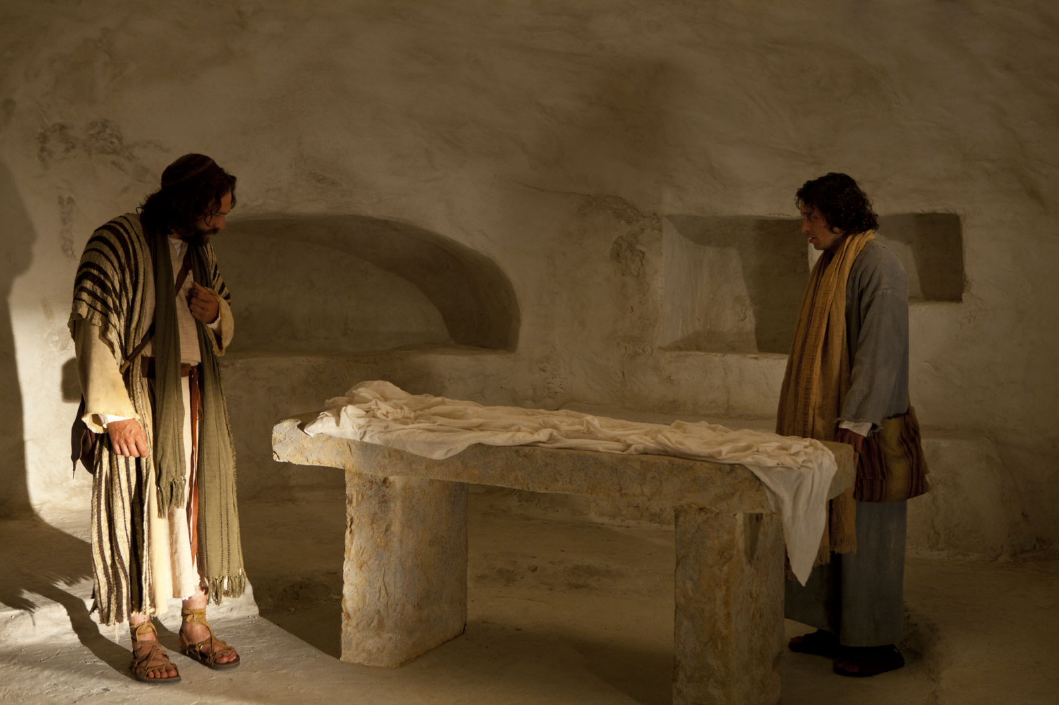

Slide 16
There are two main thoughts on what is meant by the handkerchief or facecloth being folded together in a place by itself.
First, it could mean that Jesus took the handkerchief and folded it Himself putting it in its own place to show that He was finished with it.
Second, it could also mean the handkerchief remained wrapped up like it was around Jesus’ face. Since the handkerchief and the linen cloths were not attached to each other, the handkerchief could be considered as being in a place by itself not with the linen cloths.

Slide 17
The Interpreter’s Bible notes:
The meaning of the Greek word applied to the napkin seems here to be “wound around.” As the evangelist regards the sight as a faith-creating phenomenon for the other disciple, the interpretation that thinks of the linen cloths as merely having been “rolled up” is too jejune for the context. The explanation that best fits the Johannine view of the mode of the Resurrection is that the body had been swiftly dematerialized, leaving the swathing cloths as they were, with the cloth that had been wrapped around the head still lying on the slightly raised ledge where the head had been laid, and keeping its annular shape (The Interpreter’s Bible, Abingdon Press, p. 790).

Slide 18
⁹ For as yet they did not know the Scripture, that He must rise again from the dead.
Verse 9 teaches us that they did not know the Scripture that Jesus would be raised from the dead (Ps. 16:10) even though He told them many times that He would be (Lk. 9:22; 18:33; 24:7).

Slide 19
John 20:11 But Mary stood outside by the tomb weeping, and as she wept she stooped down and looked into the tomb. ¹² And she saw two angels in white sitting, one at the head and the other at the feet, where the body of Jesus had lain. ¹³ Then they said to her, "Woman, why are you weeping?" She said to them, "Because they have taken away my Lord, and I do not know where they have laid Him."

Slide 20
John 20:14 Now when she had said this, she turned around and saw Jesus standing there, and did not know that it was Jesus. ¹⁵ Jesus said to her, "Woman, why are you weeping? Whom are you seeking?" She, supposing Him to be the gardener, said to Him, "Sir, if You have carried Him away, tell me where You have laid Him, and I will take Him away." ¹⁶ Jesus said to her, "Mary!" She turned and said to Him, "Rabboni!" (which is to say, Teacher).

Slide 21
¹⁷ Jesus said to her, "Do not cling to Me, for I have not yet ascended to My Father; but go to My brethren and say to them, 'I am ascending to My Father and your Father, and to My God and your God.' " ¹⁸ Mary Magdalene came and told the disciples that she had seen the Lord, and that He had spoken these things to her.

Slide 22
First, she thought He was dead and would not have expected to see Him alive, so it did not register in her mind that it was Him.
Second, she was crying and grieving and would not have paid much attention to the details of His face, and the tears in her eyes would also impede her vision.
Third, verse 16 indicates that she had turned away from Jesus because when Jesus said, “Mary!” John says that Mary “turned and said to Him, "Rabboni!" (which is to say, Teacher).”

Slide 23
Matthew 28:9 And as they went to tell His disciples, behold, Jesus met them, saying, "Rejoice!" So they came and held Him by the feet and worshiped Him. 10 Then Jesus said to them, "Do not be afraid. Go and tell My brethren to go to Galilee, and there they will see Me."

Slide 24
Both Luke and Mark tell us that the apostles did not believe these women or Mary Magdalene when they told them about their experience (Lk. 24:9-11; Mk. 16:10-11).

